Slide 1
UCS1603 –OBJECT ORIENTED ANALYSIS AND DESIGN
UNIT – I - INTRODUCTION

Slide 2
UNIT I INTRODUCTION
Introduction
OOAD
Two Orthogonal Views of the Software
Why object orientation
Object basics
Object oriented systems development life cycle

Slide 3
TEXT BOOK:
1. Ali Bahrami, “Object Oriented Systems Development”, McGraw Hill Education, Indian Edition, 2004.
2. Martin Fowler, “UML Distilled“, 2nd Edition, Prentice Hall of India / Pearson Education, 2002.
REFERENCES:
1.Stephen R. Schach, “Introduction to Object Oriented Analysis and Design”, Tata McGraw - Hill, 2003.
2. James Rumbaugh, Ivar Jacobson and Grady Booch,” The Unified Modeling Language Reference Manual”, Addison Wesley, 1999.
3.Hans – Erik Eriksson, Magnus Penker, Brain Lyons and David Fado, “UML Toolkit”, OMG Press Wiley Publishing Inc., 2004.
4.Barclay, “Object-Oriented Design with UML and Java”, Elsevier, 2008.

Slide 4
INSTITUTE VISION AND MISSION
VISION OF THE INSTITUTE:
To achieve a prominent position among the top technical institutions.
MISSION OF THE INSTIITUTE:
M1: To bestow standard technical education par excellence through state of the art infrastructure, competent faculty and high ethical standards.
M2: To nurture research and entrepreneurial skills among students in cutting edge technologies.
M3: To provide education for developing high-quality professionals to transform the society.

Slide 5
DEPARTMENT VISION AND MISSION
VISION OF THE DEPARTMENT:
To create eminent professionals of Computer Science and Engineering by imparting quality education.
MISSION OF THE DEPARTMENT:
M1: To provide technical exposure in the field of Computer Science and Engineering through state of the art infrastructure and ethical standards.
M2: To engage the students in research and development activities in the field of Computer Science and Engineering.
M3: To empower the learners to involve in industrial and multi-disciplinary projects for addressing the societal needs.

Slide 6
COURSE OUTCOMES:
Upon completion of the course, the students will be able to
Illustrate the basics of object oriented system development concepts.
Apply conventional frameworks and data modelling concepts for designing software.
Identify attributes, objects to define relationships using decision support models for software design.
Utilize object oriented design principles to design software.
Use software quality assurance techniques to improve the software quality.

Slide 7

Goals
The object-oriented philosophy and why we need to study it.
The unified approach.
Object-Oriented Systems Development

Slide 8
SYSTEMS DEVELOPMENT
System development refers to all activities that produce an information systems solution.
System development activities are,
Analysis
Modeling
Design
Implementation
Testing
Maintenance
A software development methodology is a series of processes that can lead to the development of an application.
Two orthogonal views of the software,
Algorithms + Data structures = Programs
Program: A software system is a mechanism for performing certain action on certain data.
Object-Oriented Systems Development

Slide 9
The two orthogonal views of the software
Traditional system development methodology
This approach focuses on the “Functions”.
Object oriented system development
This approach focuses on the “Object” which combines “Data and Functionality”.
Object-Oriented Systems Development

Slide 10
The two orthogonal views of the software
Traditional system development methodology
This approach focuses on the “Functions”.
Object oriented system development
This approach focuses on the “Object” which combines “Data and Functionality”.
Object-Oriented Systems Development

Slide 11
Introduction
Object-Oriented (OO) systems development is a way to develop software by building self- contained modules that can be more easily:
Replaced
Modified
and Reused.

Slide 12

What is a Software development methodology?
Practices, procedures, and rules used to develop software.

Slide 13
Systems Development Methodologies
Systems development methodology is a way to develop system.
A comprehensive system development methodology utilizes sets of tools as well as the style in which they are to be used.

Slide 14
Traditional Systems Development Methodology
Traditional or Structured approach is based on the idea that a system can be thought of as a collection of modules or subsystems.
It is much easier to work with a smaller cohesive module than a complex system.

Slide 15
Object-Oriented Systems Development Methodology
In an O-O environment, software is a collection of discrete objects.
These objects encapsulate their data and functionalities to model real world "objects."

Slide 16

Object-Oriented Systems Development Methodology (Con’t)
An object-oriented life cycle encourages a view of the world as a system of cooperative and collaborating agents.

Slide 17
Benefits of Object Orientation
Faster development,
Reusability,
Increased quality,
and easier maintenance.

Slide 18
OO Benefits (Con’t)
Object technology emphasizes modeling the real world and provides us with the stronger equivalence of the real world’s entities (objects) than other methodologies.
Raising the level of abstraction to the point where application can be implemented in the same terms as they are described.

Slide 19
WHY AN OBJECT ORIENTATION?
To create sets of objects that work together with to produce software the problem.
The systems are easier to adapt to changing requirements, easier to maintain, more robust and promote greater design and code reuse.
Object oriented development allows us to create modules of functionality.
Once objects are defined, they will perform their desired functions.
Here are some reasons,
Higher level of abstraction
Seamless transition among different phases of software development.
Encouragement of good programming techniques
Promotion of reusability

Slide 20
WHY AN OBJECT ORIENTATION?(Con’t)
Encouragement of good programming techniques
Object oriented languages produce more modular and reusable code via the concepts of class and inheritance.
The object-oriented languages are C++, Smalltalk or Java.
Promotion of reusability
Objects are reusable because they are modeled directly out of a real-world problem domain.
The object orientation adds inheritance which is a powerful technique that allows classes to be built from each other.

Slide 21
WHY AN OBJECT ORIENTATION?(Con’t)
Higher level of abstraction
The top-down approach supports abstraction at the function level
The object-oriented approach supports abstraction at the object level.Since “objects encapsulate both data and functions they work at a higher level of abstraction.”
Seamless transition among different phases of software development.
The object-oriented approach essentially uses the same language to talk about analysis, design, programming, database design.
This seamless approach reduces the level of complexity and redundancy and makes for clear, more robust system development.

Slide 22
Unified Approach
The unified approach (UA) is a methodology for software development that is used in this book.
The UA, based on methodologies by Booch, Rumbaugh, Jacobson, and others, tries to combine the best practices, processes, and guidelines.

Slide 23
Unified Approach (Con’t)
UA utilizes the unified modeling language (UML) which is a set of notations and conventions used to describe and model an application.
Object-Oriented Systems Development

Slide 24
Layered Architecture
UA also uses a layered architecture to develop applications.
The layered approach consists of view or user interface, business, and access layers.

Slide 25



Layered Architecture (Con’t)
This approach reduces the interdependence of the user interface, database access, and business control.
Therefore, it allows for a more robust and flexible system.

Slide 26
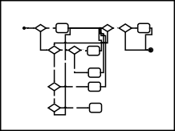
Analysis
Design
Prototyping and Testing
1. Identify the users/actors (Chapter 6): Who is (or will be) using the system?
Apply design axioms to design classes, their attributes, methods, associations, structures, and protocols (Chapter 9)
Refine and complete the static UML class diagram (object model) by adding details to the UML class diagram (Chapter 10)
Refine attributes
Design methods and protocols by utilizing UML activity diagram for representation of method algorithm
Refine (if required) associations between classes
Refine (if required) class hierarchy and design with
inheritance
6.2 Iterate and refine (reapply Design axioms).
ViaNet Bank ATM Sytem
BankClient #firstName : String
#lastName :String
#cardNumber : String #pinNumber : String
ATMMachine
#address : String #state : String
Account
#account : Account
+verifyPassword()
1..
Transaction
*
#transID : String
Account
#transDate : Date
^{#number: String} #transTime : Time #balance : float * Account- #transType : String
#bankClient: BankClient Transaction #amount :float
#transaction: Transaction ¹
+deposit()
#postBalance : float #account : Account
+withdraw() #retrieveAccount()
2. Develop a simple business
#updateAccount() #createTransaction()
Member
CheckingAccount SavingsAccount
#savings : Account ^{1 Savings-} #checking : Account
Checking
1
comes in Go to counter
^{Return} Yes and return the Book?
Checking ^{Go to counter}
book
^{Done? Yes} out Books? ^{and check out}
process model
the book
+withdraw()
Borrow Inter Inter Library Books? ^{Yes Libray} Yes ^{Loan Section,}
Loan? check out
book
Refine UML Class diagram
The advantage of developing a business process model is that it familiarizes you with the system and therefore the
No
No
No Search for the book in the
library
Perform Research?
Yes ^{Do Research}
No
on the topic
Read
Sit
somewhere
newspaper Yes quiet and read
/books
newspaper, books, etc.
CheckingAccount::+withdraw (anAmount:Float):ReturnCode:String
Withdraw using
Account class Account.withdraw (anAmount)
method
user requirements
Business process modeling using activity diagram
account
Doesn't have savings acount has savings
^{sufficient funds} account
SavingsAccount.withdraw ^{withdraw using} SavingsAccount.balance - ^{SavingsAccount} (anAmount -
insufficient funds
method
CheckAccount.balance))
insufficient funds
3. Develop the use case (Chapter 6): What are (or will be) the users are
sufficient funds
returnCode = "OK"
returnCode
="Insufficient funds"
doing with the system?
Use cases provide comprehensive documentation of the system under
Design methods by utilizing UML Activity Diagram
study
Use case diagrams
Use cases capture the goal of the users and the responsibility of the
7.0 Design the access ayer (Chapter 11)
Create maccess layer classes by mirroring the business classes
Define relationships
Simplify classes and structures
Eliminate redundant classes
Eliminate method classes
Business Classes
BanK
Enter title here
system to its users
BankClient
#firstName : String #lastName :String #cardNumber : String
#pinNumber : String #account : Account #bankDB: BankDB
+verifyPassword()
Has 1
ATMMachine
#address : String #state : String
Create User Interface controls
1..
* ^{Transaction}
Account #transID : String
Cancel OK
4. Interaction diagrams
Access Class(es)
#number: String Account- #transDate : Date
#balance : float * ^{Transaction} #transTime : Time #bankClient: BankClient #transType : String
Create the forms and controls
BankDB
#transaction: Transaction 1 #bankDB: BankDB
+deposit()
+withdraw() #createTransaction()
#retrieveAccount() #updateAccountt()
#amount :float #postBalance : float #account : Account
Associate actions to the User Interface controls and their events
Enter title here
(Chapter 7)
Bank Client ATM Machine
Account
Checking Account
+retrieveClient()
+updateClient()
+retrieveSavingsAccount()
+updateSavingsAccount()
+retrieveCheckingAccount()
+updateCheckingAccount()
4.1 Develop sequence
^{CheckingAccount} SavingsAccount
#savings : Account 1 Savings- #checking : Account
+withdraw() ^{Checking}
-retrieveAccount() ¹ -retrieveAccount()
-updateAccountt() -updateAccountt()
Cancel OK
diagrams
Request Kind
7.4 Iterate and refine
UML Class diagram with added access and view classes
Enter title here
Add Actions
4.2 Develop
Enter Kind
Request Amount
Test/Debug
collaboration diagrams.
4.3 Iterate and refine
Enter Amount
^{Process Transaction} Account
Transaction succeed
Dispense Cash
Request Take Cash
Take Cash
Cancel OK
Request Continuation
Done
Test the UI
collaboration diagram
Print Receipt
Sequence diagram
Designing view layer classes (Chapter 12)
Macro-level UI design Process- Identifying View layer Objects
Micro-level UI design activities:
Designing the view layer objects by applying design
Prototype user interface
Classification (Chapter 8)
Identify Classes
Identify Relationships
Identify Attributes
axioms and corollaries
8.2.2 Prototyping the view layer interface.
8.3. Usability and user satisfaction testing (Chapter 14):
How do you rate the ViaNet Bank ATM Kiosk Interface?
Is easy to operate:
10 9 8 7 6 5 4 3 2 1
Very easy to use Very Hard to use
1
1..
Buttons are right size and easily can be located:
10 9 8 7 6 5 4 3 2 1
*
*
Very appropriate
Not appropriate
1
8.4 Iterate and refine
Is efficient to use:
Very efficient
10 9 8 7 6 5 4 3 2 1
Very inefficient
Identify Methods
Iterate and refine.
Is Fun to use: 10 9 8 7 6 5 4 3 2 1
Very Not Fun at all
1
1
^{Is visually pleasing:} 10 9 8 7 6 5 4 3 2 1
Very pleasing
Not pleasing
Class diagram
Provides easy recovery from errors:
10 9 8 7 6 5 4 3 2 1
The process of creating sequence or collaboration diagrams is a systematic way to think about how a use case can take place, and by
Comments:
Very easy recovery
Not at all
9. Iterate and refine the design/analysis: If needed repeat the preceding
I have more to say, I would like to see you.
doing so, it forces you to think about objects involves in your
steps
Usability and user satisfaction testing
application

Slide 27

Summary
In an object-oriented environment, software is a collection of discrete objects that encapsulate their data and the functionality to model real-world objects.

Slide 28
Summary (Con’t)
An object orientation produces systems that are easier to evolve, more flexible, more robust, and more reusable than other traditional approaches.

Slide 29
Summary (Con’t)
This book is organized around the unified approach.
The UA, based on methodologies by Booch, Rumbaugh, Jacobson, and others, tries to combine the best practices, processes, and guidelines along with the Object Management Group's Unified Modeling Language (UML).
Object-Oriented Systems Development

Slide 30
Object Basics

Slide 31
Goals
Define Objects and classes
Describe objects’ methods, attributes and how objects respond to messages,
Define Polymorphism, Inheritance, data abstraction, encapsulation, and protocol,
Object-Oriented Systems Development

Slide 32
Goals (Con’t)
Describe objects relationships,
Describe object persistence,
Understand meta-classes.

Slide 33

What is an object?
The term object was first formally utilized in the Simula language to simulate some aspect of reality.
An object is an entity.
It knows things (has attributes)
It does things (provides services or has methods)

Slide 34



It Knows things (attributes)
I am an Employee. I know my name,
social security number and my address.

Slide 35
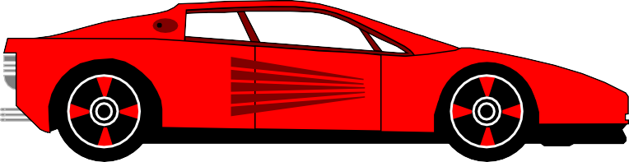
Attributes (Con’t)
I am a Car.
I know my color, manufacturer, cost, owner and model.

Slide 36

Attributes (Con’t)
I am a Fish.
I know my date of arrival and expiration.
Object-Oriented Systems Development

Slide 37



It does things (methods)
I know how to compute
my payroll.

Slide 38

Methods (Con’t)
I know how to stop.

Slide 39

Methods (Con’t)
I know how
to cook myself.

Slide 40
What is an object? (Con’t)
Attributes or properties describe object’s state (data) and methods define its behavior.

Slide 41
Object is whatever an application wants to talk about.
For example, Parts and assemblies might be objects of bill of material application.
Stocks and bonds might be objects of financial investment applications.

Slide 42
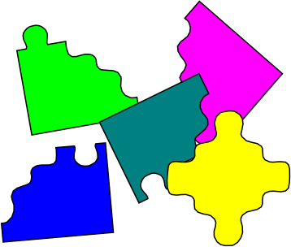
Objects
In an object-oriented system, everything is an object: numbers, arrays, records, fields, files, forms, an invoice, etc.

Slide 43
Objects (Con’t)
An Object is anything, real or abstract, about which we store data and those methods that manipulate the data.
Conceptually, each object is responsible for itself.

Slide 44
Objects (Con’t)
● A window object is responsible for things like opening, sizing, and closing itself.
● A chart object is responsible for things like maintaining its data and labels, and even for drawing itself.

Slide 45
Two Basic Questions
When developing an O-O application, two basic questions always arise.
What objects does the application need?
What functionality should those objects have?

Slide 46

Traditional Approach
The traditional approach to software development tends toward writing a lot of code to do all the things that have to be done.
You are the only active entity and the code is just basically a lot of building materials.

Slide 47

Object-Oriented Approach
OO approach is more like creating a lot of helpers that take on an active role, a spirit, that form a community whose interactions become the application.

Slide 48
Object’s Attributes
Attributes represented by data type.
They describe objects states.
In the Car example the car’s attributes are:
color, manufacturer, cost, owner, model, etc.

Slide 49
Object’s Methods
Methods define objects behavior and specify the way in which an Object’s data are manipulated.
In the Car example the car’s methods are:
drive it, lock it, tow it, carry passenger in it.

Slide 50
Objects are Grouped in Classes
The role of a class is to define the attributes and methods (the state and behavior) of its instances.
The class car, for example, defines the property color.
Each individual car (object) will have a value for this property, such as "maroon," "yellow" or "white."

Slide 51






Employee Class
John object
Jane object
Mark object

Slide 52
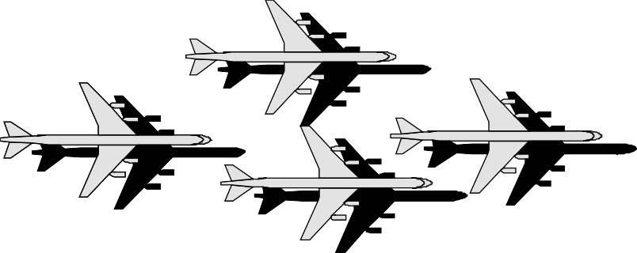


A Class is an Object Template, or
an Object Factory.
B o e ing A i rp l a ne O b j e c ts
( B o e in g in s tan c e s )

Slide 53
Class Hierarchy
An object-oriented system organizes classes into subclass- super hierarchy.
At the top of the hierarchy are the most general classes and at the bottom are the most specific

Slide 54
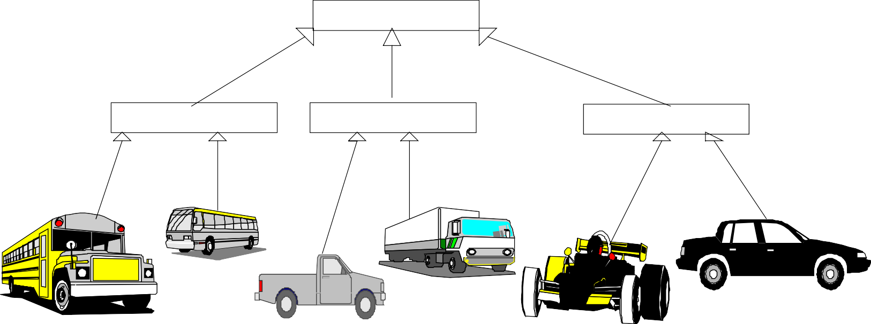
Class Hierarchy (Con’t)
A subclass inherits all of the properties and methods (procedures) defined in its superclass.
Motor Vehicle
Bus
Truck
Car

Slide 55
Inheritance (programming by extension )
Inheritance is a relationship between classes where one class is the parent class of another (derived) class.

Slide 56
Inheritance (Con’t)
Inheritance allows classes to share and reuse behaviors and attributes.

Slide 57
Inheritance (Con’t)
The real advantage of inheritance is that we can build upon what we already have and,
Reuse what we already have.

Slide 58

Inheritance (Con’t)
Vehicle
Car
I know how to stop
stop method is reusable
Ford
M ustang
Taurus
Thunderbird
I don know how to stop
stop (myM ustang)

Slide 59
Multiple Inheritance
OO systems permit a class to inherit from more than one superclass.
This kind of inheritance is referred to as multiple inheritance.

Slide 60
Multiple Inheritance (Con’t)
For example utility vehicle inherents from Car and Truck classes.
MotorVehicle
Truck
Car
Bus
UtilityVehicle

Slide 61
Encapsulation and Information Hiding
Information hiding is a principle of hiding internal data and procedures of an object.
Permissible operations
Data
Private Protocol
Public Protocol
Massages

Slide 62
Encapsulation and Information Hiding (Con’t)
By providing an interface to each object in such a way as to reveal as little as possible about its inner workings.
Encapsulation protects the data from corruption.

Slide 63

Protocol
Protocol is an interface to the object.
TV contains many complex components, but you do not need to know about them to use it.

Slide 64
Message
Objects perform operations in response to messages.
For example, you may communicate with your computer by sending it a message from hand-help controller.

Slide 65
A Case Study - A Payroll Program
Consider a payroll program that processes employee records at a small manufacturing firm. This company has three types of employees:
1. Managers: Receive a regular salary.
2. Office Workers: Receive an hourly wage and are eligible for overtime after 40 hours.
3. Production Workers: Are paid according to a piece rate.

Slide 66
Structured Approach
FOR EVERY EMPLOYEE DO BEGIN
IF employee = manager THEN CALL computeManagerSalary
IF employee = office worker THEN CALL computeOfficeWorkerSalary
IF employee = production worker
THEN CALL
computeProductionWorkerSalary
END

Slide 67
What if we add two new types of employees?
Temporary office workers ineligible for overtime,
Junior production workers who receive an hourly wage plus a lower piece rate.

Slide 68
FOR EVERY EMPLOYEE DO BEGIN
IF employee = manager THEN CALL computeManagerSalary
IF employee = office worker THEN CALL computeOfficeWorker_salary
IF employee = production worker THEN CALL computeProductionWorker_salary
IF employee = temporary office worker THEN CALL computeTemporaryOfficeWorkerSalary
IF employee = junior production worker THEN CALL computeJuniorProductionWorkerSalary
END

Slide 69

An Object-Oriented Approach
What objects does the application need?
The goal of OO analysis is to identify objects and classes that support the problem domain and system's requirements.
Some general candidate classes are:
Persons
Places
Things

Slide 70
What are some of the application’s classes?
Employee
Manager
Office Workers
Production Workers

Slide 71
Class Hierarchy
Identify class hierarchy
Identify commonality among the classes
Draw the general-specific class hierarchy.

Slide 72
Class Hierarchy (Con’t)
Employee
name address salary SS#
OfficeWorker
Manager
ProductionWorker
dataEntry ComputePayroll printReport
dataEntry
ComputePayroll printReport
dataEntry ComputePayroll printReport

Slide 73
OO Approach
FOR EVERY EMPLOYEE DO BEGIN
employee computePayroll END

Slide 74
If a new class of employee were
added
E m ployee
nam e address salary SS#
O ffice W orker
M anager
Production W orker
data E ntry
C om pute P ayroll printR eport
data E ntry
C om pute P ayroll printR eport
data E ntry
C om puteP ayroll printR eport
Tem porary O ffice W orker
C om puteP ayroll
Junior Production W orker
C om puteP ayroll

Slide 75
Polymorphism
Polymorphism means that the same operation may behave differently on different classes.
Example: computePayroll

Slide 76
Associations
The concept of association represents relationships between objects and classes.
For example a pilot can fly planes.

Slide 77
Associations (Con’t)
Pilot
can fly
flown by
Planes

Slide 78
Clients and Servers
A special form of association is a client-server relationship.
This relationship can be viewed as one-way interaction: one object (client) requests the service of another object (server).

Slide 79
Clients and Servers (Con’t)
PrintServer
Request for printing
Item

Slide 80
Objects and Persistence
Objects have a lifetime.
An object can persist beyond application session boundaries, during which the object is stored in a file or a database, in some file or database form.

Slide 81
Meta-Classes
Everything is an object.
How about a class?
Is a class an object?
Yes, a class is an object! So, if it is an object, it must belong to a class.
Indeed, class belongs to a class called a Meta-Class or a class' class.

Slide 82
Meta-Classes (Con’t)
Meta-class used by the compiler. For example, the meta-classes handle messages to classes, such as constructors and "new."

Slide 83
Summary
Rather than treat data and procedures separately, object- oriented programming packages them into "objects."
O-O system provides you with the set of objects that
closely reflects the underlying application

Slide 84
Summary (Con’t)
Advantages of object-oriented programming are:
The ability to reuse code,
develop more maintainable systems in a shorter amount of time.

Slide 85
Summary (Con’t)
more resilient to change, and
more reliable, since they are built from completely tested and debugged classes.

Slide 86
Object-Oriented Systems Development Life Cycle

Slide 87
Goals
The software development process
Building high-quality software
Object-oriented systems development

Slide 88
Goals (Con’t)
Use-case driven systems development
Prototyping
Rapid application development
Component-based development
Continuous testing and reusability

Slide 89
Software Process
The essence of the software process is the transformation of
Users’ needs to
The application domain into
A software solution.

Slide 90


Software Process (Con’t)
Problem
Statements
Transformation 1
What are the uses of the system.?
Needs
Analysis
Need
Transformation 2
Design
Implementation
System
Software
Product
Transformation 3
Detail

Slide 91
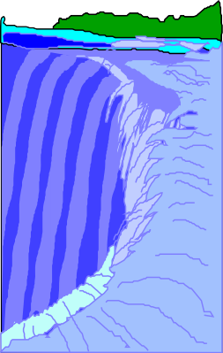













Traditional Waterfall Approach to Systems Development
W h a t
H o w
Do It
T e st
U se

Slide 92

Software Quality
There are two basic approaches to systems testing.
We can test a system according to how it has been built.
Alternatively, we can test the system with respect to what it should do.

Slide 93

Quality Measures
Systems can be evaluated in terms of four quality measures:
Correspondence
Correctness
Verification
Validation

Slide 94
Quality Measures (Con’t)
Correspondence measures how well the delivered system corresponds to the needs of the operational environment.
N
e e d
s
R e q u
i r e
m e n t s
D e s i g n
S o f t w a r e
C o r r e s p o n d e n c e

Slide 95
How would you determine
Correspondence?
It cannot be determined until the system is in place.

Slide 96
Quality Measures (Con’t)
Correctness measures the consistency of the product requirements with respect to the design specification.
N e e d s
R e q
u ir e
m e n ts
D
e s i
g n
S o f t w a r e
C o r r e c tn e s s

Slide 97
Quality Measures (Con’t)
Verification - "Am I building the product right?"
Validation - "Am I building the right product?"
V a lid a tio n
V e r i f ic a t io n
N ee d s
R e q
u ir e
m e n ts
D e s ig n
So f tw a r e

Slide 98

Quality Measures (Con’t)
Verification is to predict the correctness.
Validation is to predict the correspondence.

Slide 99









Object-Oriented Systems
Development Approach
Build
Use-Cases
Build use-case
_{model} Validate/ Test
Object analysis
Valida
te/
test
O-O Analysis
Iteration and Reuse
Using TOOLS CASE and/or OO programing languages
User satisfaction Usability & QA Tests
Design classes, define attributes and methods
Build object & dynamic model
Build UI and prototype
O-O
User satisfaction test, usability test
quality assurance test
Implementation
O-O Design

Slide 100
Object-Oriented Systems Development activities
Object-oriented analysis.
Object-oriented design.
Prototyping.
Component-based development.
Incremental testing.

Slide 101




Use-case driven systems
development
Use Case, is a name for a scenario to describe the user–computer system interaction.
Use case models/ documnet
OOA: Identify Actors
OOA: Use case Model
OOA: Courses of action
Object interaction diagram, etc.
Design classes UI
Dynamic model
OOA: Object Model
OOD: Dynamic model
Testing: Usage Scenarios

Slide 102
Object-Oriented Analysis
OO analysis concerns with determining the system requirements and identifying classes and their relationships that make up an application.

Slide 103
Object-Oriented Design
The goal of object-oriented design
(OOD) is to design:
The classes identified during the analysis phase,
The user interface and
Data access.

Slide 104
Object-Oriented Design (Con’t)
OOD activities include:
– Design and refine classes.
Design and refine attributes.
Design and refine methods.
Design and refine structures.
Design and refine associations.
– Design User Interface or View layer classes.
– Design data Access Layer classes.

Slide 105
Prototyping
A Prototype enables you to fully understand how easy or difficult it will be to implement some of the features of the system.
It can also give users a chance to comment on the usability and usefulness of the design.

Slide 106
Types of Prototypes
A horizontal prototype is a simulation of the interface.
A vertical prototype is a subset of the system features with complete functionality.

Slide 107
Types of Prototypes (Con’t)
An analysis prototype is an aid for exploring the problem domain.
A domain prototype is an aid for the incremental development of the ultimate software solution.

Slide 108
Component-based development (CBD)
CBD is an industrialized approach to the software development process.
Application development moves from custom development to assembly of pre-built, pre-tested, reusable software components that operate with each other.

Slide 109
Component-based development
(CBD) Con’t)
Component wrapper
Component wrapper
Subselect and enter title here
Legacy programs
Legacy data
Open Connectivity
Component wrapper
Component wrapper
Legacy screens
Legacy software packages

Slide 110
Rapid Application Development (RAD)
RAD is a set of tools and techniques that can be used to build an application faster than typically possible with traditional methods.

Slide 111
Rapid Application Development (RAD) (Con’t)
RAD does not replace SDLC but complements it, since it focuses more on process description and can be combined perfectly with the object-oriented approach.

Slide 112
Incremental Testing
Software development and all of its activities including testing are an iterative process.
If you wait until after development to test an application for bugs and performance,
you could be wasting thousands of dollars and hours of time.

Slide 113
Reusability
A major benefit of object-oriented systems development is reusability, and this is the most difficult promise to deliver on.

Slide 114
Reuse strategy
Information hiding (encapsulation).
Conformance to naming standards.
Creation and administration of an object repository.

Slide 115
Reuse strategy (Con’t)
Encouragement by strategic management of reuse as opposed to constant redevelopment.
Establishing targets for a percentage of the objects in the project to be reused (i.e., 50 percent reuse of objects).

Slide 116

Summary
The essence of the software process is the transformation of users’ needs into a software solution.
The O-O SDLC is an iterative process and is divided into analysis, design, prototyping/ implementation, and testing.

Slide 117
APPLICATIONS
Develop a e-commerce platform
Develop a e- voting system
Develop online gaming system

Slide 118
NPTEL VIDEOS LINK
https://onlinecourses.nptel.ac.in/noc23_cs46/unit?unit=18&lesson=20
https://onlinecourses.nptel.ac.in/noc23_cs46/unit?unit=18&lesson=23

